Slide 1

AtliQ Grands
AltiQ Hospitality Analysis
Presented by
Hamza Ali Ghaffar
Data Analyst/ BI developer
Oct - 2023

Slide 2
Content
Introduction
Problem Statement
Solution and Approach
Mock Up Dashboard
Dataset and Training
Model View
Key Metrics
Insights
Actionable Insights
Impact
Conclusion
AltiQ Hospitality Analysis
Oct - 2023
2

Slide 3
1. Introduction
AtliQ Grands is a luxury hotel chain in India.
AltiQ Hospitality Analysis
Oct - 2023
3

Slide 4
2. Problem Statement
AtliQ Grands was losing market share and revenue to competitors.
They wanted to incorporate "Business and Data Intelligence" to regain their market share and revenue.
But they didn't have an in-house data analytics team.
AltiQ Hospitality Analysis
Oct - 2023
4

Slide 5
3. Solution and Approach
AtliQ Grands hired a data analyst to provide them with insights from their historical data. His task was to:
Create metrics according to the metric list provided by stakeholders
Create a dashboard according to the mock-up provided by stakeholders
Create relevant insights that are not provided in the metric list/mock-up dashboard
AltiQ Hospitality Analysis
Oct - 2023
5

Slide 6
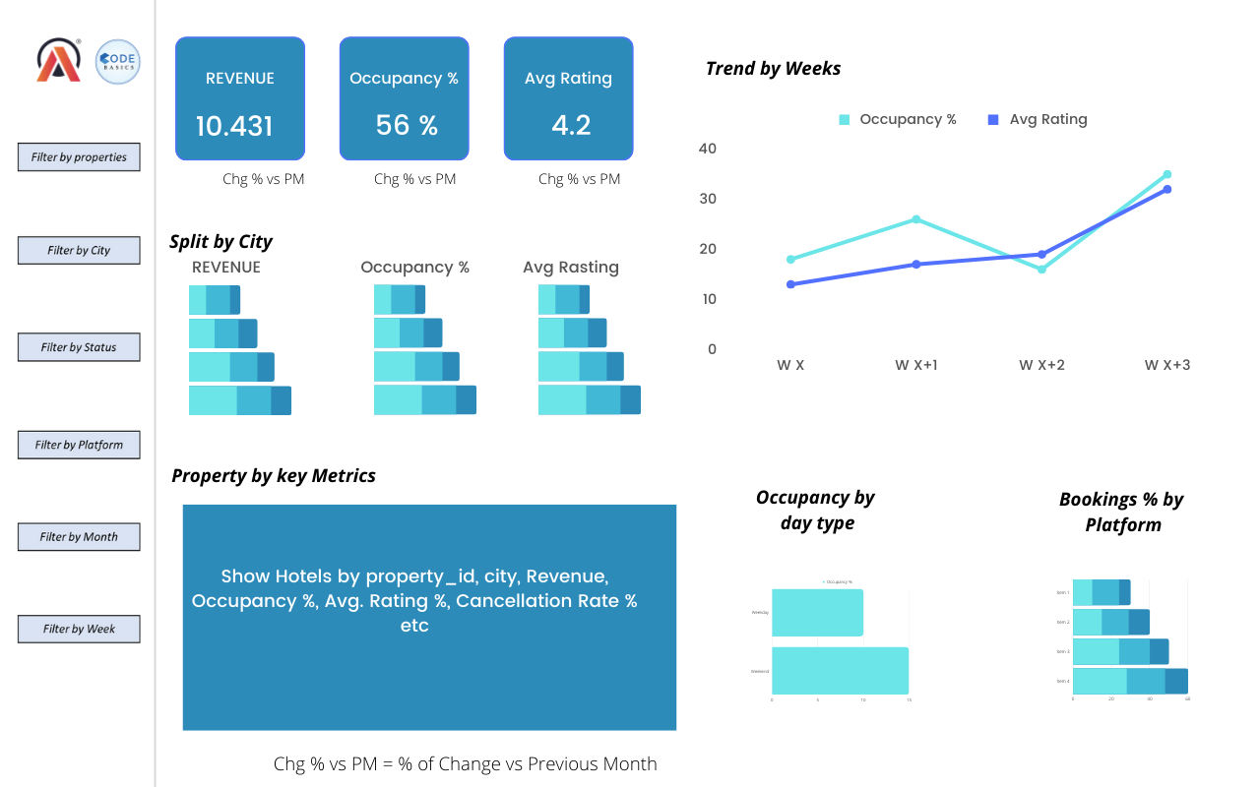
4. Mock Up Dashboard
AltiQ Hospitality Analysis
Oct - 2023
6

Slide 7
5. Dataset
They provided 3 months’ booking details of all the AtliQ hotels.
Data set contains some Excel files:
Dim_date
Dim_rooms
Dim_hotels
Dim_aggregated_booking
Fact_booking
Metric list Excel file
Mock up dashboard
AltiQ Hospitality Analysis
Oct - 2023
7

Slide 8
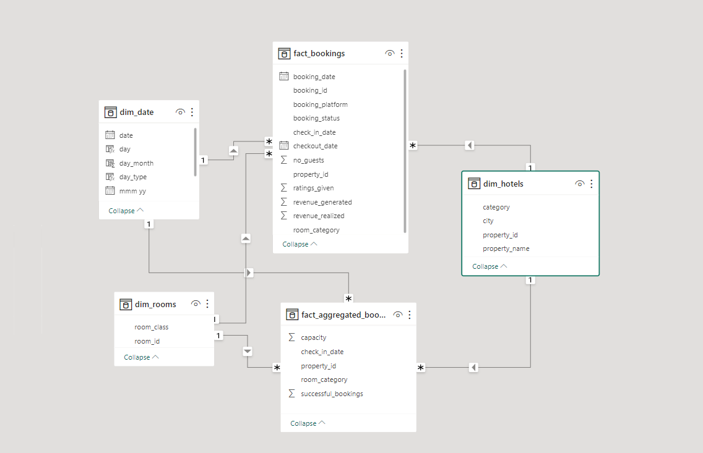
5. Model View
AltiQ Hospitality Analysis
Oct - 2023
8

Slide 9
6. Key Metrics
I created the following metrics:
Revenue
Occupancy rate
Average daily rate (ADR)
Revenue per available room (RevPAR)
Daily sellable rate nights (DSRN)
Daily Booked Room Nights (DBRN)
Daily Utilized Room Nights (DURN)
AltiQ Hospitality Analysis
Oct - 2023
9

Slide 10
7. Insights
Mumbai is a major contributor to AtliQ Grands' revenue.
Delhi has the highest occupancy rate (60%) and rating (3.8) of all AtliQ Grands hotels.
The ADR of presidential rooms is high, but elite room category revenue is also high.
The revenue of AtliQ Exotica property is high, and cancellation rates are lower than at other properties.
Occupancy is higher on weekends compared to weekdays.
AtliQ Grands is getting more bookings from third-party platforms than from its own website.
Luxury category rooms are generating more revenue than Business rooms.
AltiQ Hospitality Analysis
Oct - 2023
10

Slide 11
8. Actionable Insights
Invest in marketing and advertising campaigns to target potential guests in Mumbai and Delhi.
Develop loyalty programs to repeatedly encourage guests to stay at AtliQ Grands hotels.
Continue to invest in AtliQ Exotica property to maintain its high revenue and low cancellation rates.
Improve the user experience and booking process on AtliQ Grands' website.
Focus on attracting and retaining business travelers, especially in Delhi.
Consider offering discounts and promotions to guests who book directly through AtliQ Grands' website.
AltiQ Hospitality Analysis
Oct - 2023
11

Slide 12
9. Impact
By implementing these actionable insights, AtliQ Grands can regain its market share and revenue in the luxury/business hotels category. By focusing on key markets like Mumbai and Delhi, investing in its properties and website, and attracting and retaining business travelers, AtliQ Grands can position itself for long-term success.
AltiQ Hospitality Analysis
Oct - 2023
12

Slide 13


